Slide 1



CAPSTONE PROJECT
AI Student Helpdesk Agent for Academic Guidance and Campus Support
Presented By
Student Name: Byreeka Yashwanth Reddy
College Name: Koneru Lakshmaiah Education Foundation (Off Campus: Bachupally, Hyderabad) Department: CSE
Email ID: yashwanthreddybyreeka@gmail.com

Slide 2
OUTLINE:
Problem Statement (Should not include solution)
Proposed System/Solution
System Development Approach (Technology Used)
Algorithm & Deployment
Result (Output Image)
Conclusion
Future Scope
References

Slide 3
Problem Statement:
In academic institutions, students frequently face challenges related to attendance management, exam preparation, time planning, communication with faculty, scholarships, and general campus life. While this guidance is essential, students often do not know whom to approach, hesitate to ask repeatedly, or lack immediate access to reliable support.
As a result, many students experience confusion, stress, poor time management, and a lack of awareness about available academic and campus-related guidance. The absence of an easily accessible, always-available support system makes it difficult for students to get timely direction for non-subject-related concerns.
Therefore, there is a need for an intelligent, conversational AI-based helpdesk agent that can provide students with instant guidance, motivation, and support for academic planning, communication, and campus life in a simple and approachable manner.

Slide 4
Proposed Solution:
The proposed system aims to address the difficulties students face in obtaining timely guidance for academic planning, communication, motivation, attendance concerns, and overall campus life. This is achieved by developing an AI-powered Student Helpdesk Agent that provides instant, conversational support for students’ non-subject-related queries in a simple and accessible manner. The solution consists of the following components:
Requirement Understanding:
Identify common areas where students frequently require guidance, such as attendance management, exam preparation, time management, stress handling, scholarships, email writing, and general campus concerns.
Agent Design and Instruction Setup:
Define clear instructions for the AI agent to ensure it provides only guidance-based responses and avoids answering core subject-related academic questions. The agent is designed to act as a student support assistant rather than a subject tutor.
Topic Structuring: Organize the guidance areas into structured topics such as:
Attendance & Missed Class Guidance
Exam Preparation & Stress Management
Time Management & Semester Planning
Study & Note-Taking Help
Writing Emails & Communication Help
Scholarship Awareness & Guidance
Motivation & Productivity
General Academic & Campus Life Guidance

Slide 5
Proposed Solution:
Platform Implementation:
Implement the agent using a conversational AI platform (Botpress) to create an interactive web-based chatbot interface that students can access easily through a browser.
Response Handling Using LLM:
Utilize a large language model to understand student queries and generate responses strictly according to the defined instructions and topic scope.
User Interface Deployment:
Deploy the chatbot as a web chat interface with a simple and friendly design, allowing students to interact naturally using text.
Evaluation and Refinement:
Test the agent with different types of student queries to ensure it correctly provides guidance, maintains boundaries (no subject teaching), and delivers helpful responses. Refine instructions and topics based on observed behavior.
Result:
The system provides students with an always-available, intelligent helpdesk assistant that offers instant guidance, reduces hesitation in seeking help, and supports students in managing their academic and campus life effectively.

Slide 6
System Approach:
This section describes the overall strategy followed to design, develop, and deploy the AI Student Helpdesk Agent.
System requirements
Hardware Requirements
Computer/Laptop with internet connectivity
Web browser (Chrome/Edge/Firefox)
Basic system configuration capable of running web applications
Software Requirements
Botpress Cloud platform for chatbot development and deployment
Web browser for configuring and testing the chatbot
Access to Large Language Models (LLMs) integrated within Botpress
Text editor for preparing agent instructions and topic definitions
Other Requirements
Clearly defined agent instructions and boundaries
Structured topic list representing common student concerns
Internet hosting provided by Botpress for webchat deployment

Slide 7
System Approach:
Libraries / Technologies Used to Build the System Since the system is built using a no-code / low-code conversational AI platform, traditional programming libraries are minimal. The following technologies power the system:
Botpress Cloud – Platform used to design and deploy the chatbot
Large Language Model (GPT-4.1) – Used for understanding and generating responses to student queries
Webchat Interface – For providing an accessible browser-based chat experience
Natural Language Processing (NLP) – Enables the agent to interpret user queries in natural language
Instruction-based AI Design – Custom instructions that guide the agent’s behavior and response boundaries
This approach ensures that the system is lightweight, easy to deploy, requires minimal coding effort, and focuses primarily on intelligent guidance delivery for students.

Slide 8
Algorithm & Deployment:
Algorithm (How the Agent Works Internally)
Algorithm Type: Instruction-Driven Conversational AI
The AI Student Helpdesk Agent does not use traditional machine learning prediction algorithms. Instead, it follows an instruction-based conversational algorithm powered by a Large Language Model (LLM).
Working Logic of the Agent:
User enters a query in natural language.
The LLM interprets the intent of the query using NLP.
The agent maps the query to one of the predefined guidance topics:
Attendance guidance, Exam preparation & stress management, Study techniques, Time management, Scholarship awareness, Communication help, Motivation & productivity, Campus life guidance
The agent checks its instruction boundaries: Must provide guidance only & Must not solve subject problems
Based on the matched topic and rules, the agent generates an appropriate guidance response.
The conversation continues until the user’s concern is addressed.
This process happens dynamically for every user query without needing manual topic selection.

Slide 9
Algorithm & Deployment:
Deployment : The AI Student Helpdesk Agent is deployed using Botpress Cloud Webchat, which provides:
A browser-based chat interface
Public demo link for access
Real-time interaction with users
No additional installation required
Deployment Steps:
Agent instructions and topics configured in Botpress.
LLM (GPT-4.1) integrated as the response engine.
Webchat interface customized with bot name and appearance.
Bot published to generate a public demo link.
Users access the agent through the webchat link and interact in real time.
The deployment link to access the AI Student Helpdesk Agent created under this project: https://cdn.botpress.cloud/webchat/v3.5/shareable.html?configUrl=https://files.bpcontent.cloud/2026/01/30/14/20260130141244-0L418N3V.json

Slide 10
Result:
The AI Student Helpdesk Agent was tested with various real-world student queries across multiple guidance categories. The agent successfully understood user intent using natural language input and provided appropriate guidance responses based on its predefined topics and instruction rules.
The agent demonstrated the following results:
Correctly guided students on attendance, exam stress, study methods, time management, scholarships, communication, and motivation.
Maintained strict instruction boundaries by refusing to solve subject-related academic problems and redirecting users to guidance.
Provided real-time, conversational responses through the webchat interface.
Handled greetings and conversational interactions naturally.
The effectiveness of the system was validated through multiple test conversations, and screenshots of these interactions are included below as visual proof of the agent’s performance.

Slide 11
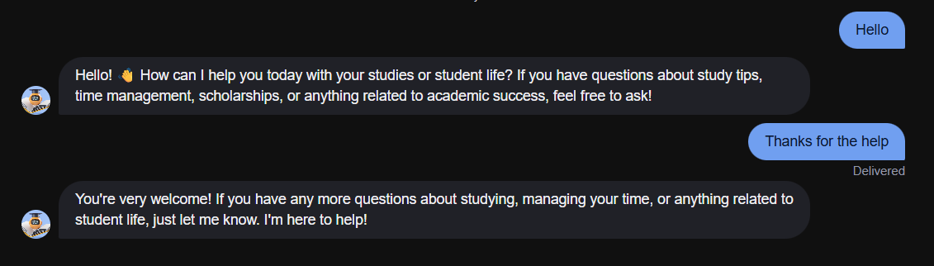
Results 1:
The agent responds politely to basic greetings and initiates a helpful conversation with the user.

Slide 12
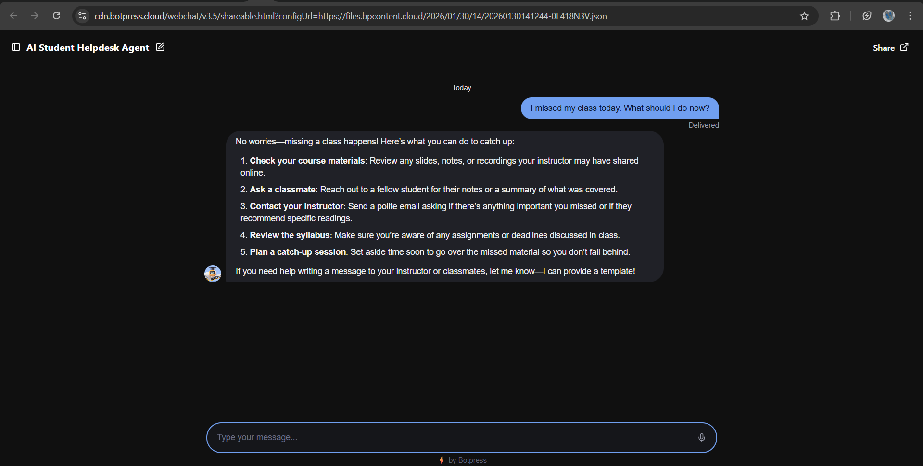
Results 2:
Agent provides practical guidance when a student misses a class and suggests responsible steps to stay on track academically.

Slide 13
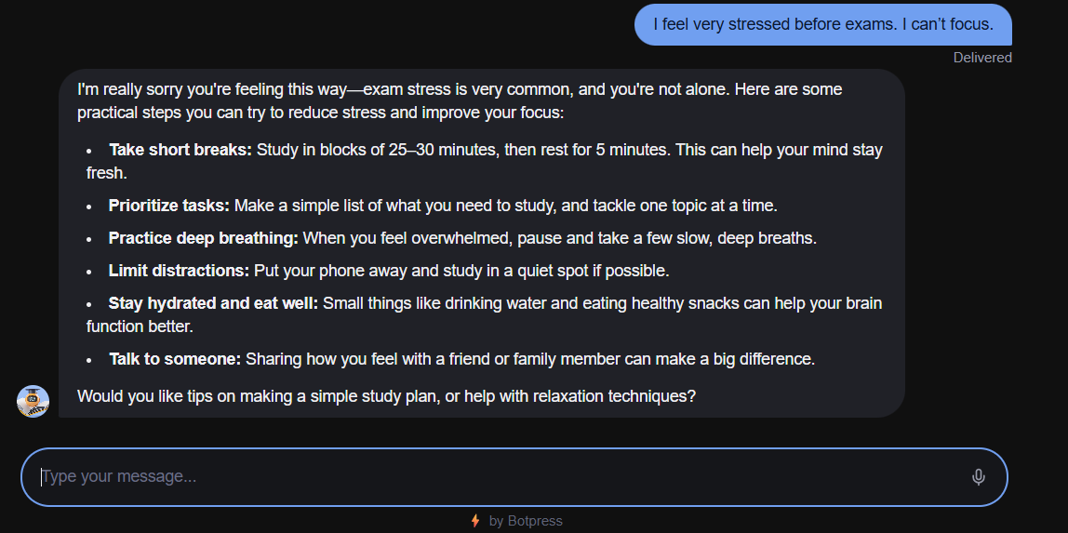
Results 3:
The agent supports students emotionally by giving strategies to manage exam stress and improve focus.

Slide 14
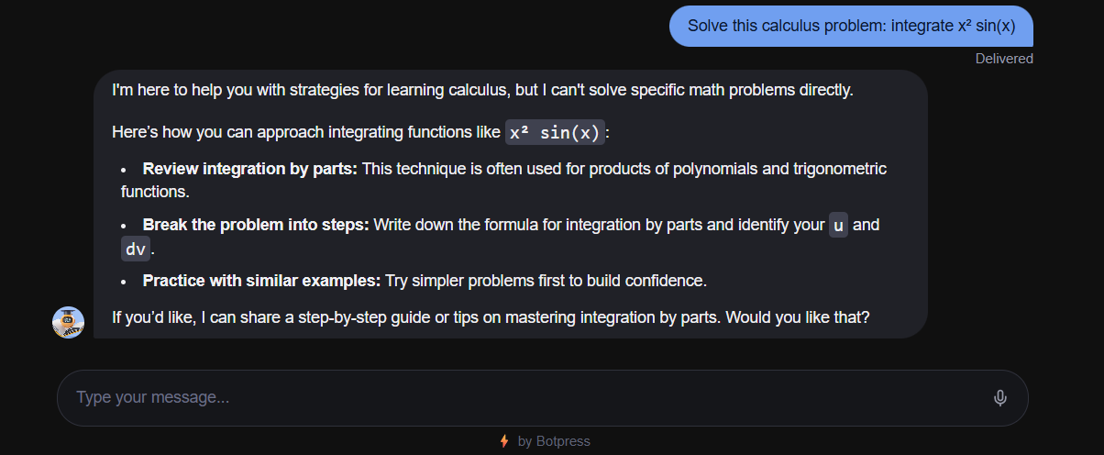
Results 4:
The agent correctly avoids solving subject-specific problems and instead guides the student towards proper learning resources, as per its design instructions. Thus, encouraging Self-learning process.

Slide 15
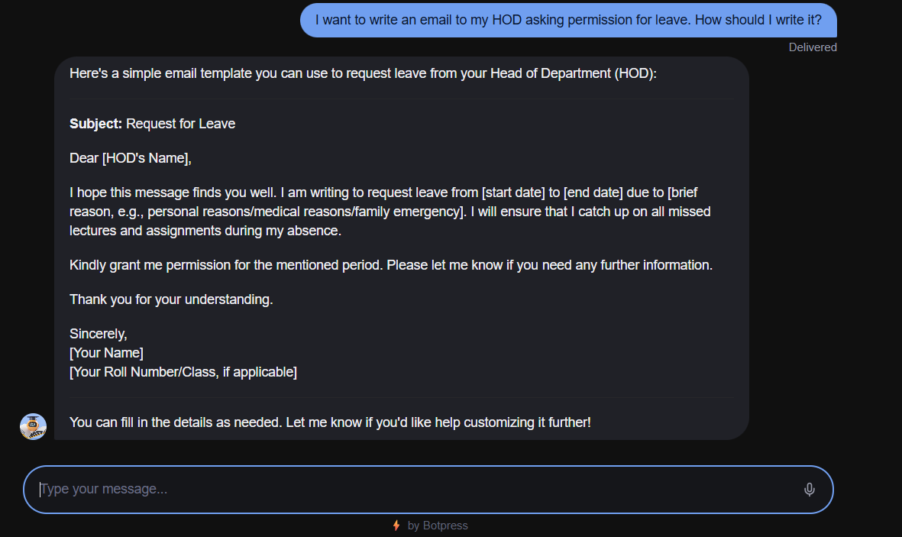
Results 5:
The agent helps students draft professional emails and maintains polite conversation flow until the interaction ends.

Slide 16
Conclusion:
The AI Student Helpdesk Agent was developed to provide students with reliable guidance for common academic and campus-related concerns such as attendance issues, exam stress, time management, communication, and study strategies. The system was designed with clear instructional boundaries to ensure that it offers guidance without directly solving subject-specific problems, encouraging students to learn responsibly.
The implementation demonstrated that conversational AI can effectively simulate a student support assistant by providing timely, structured, and polite responses to a wide range of student queries. The agent also successfully handles greetings, gratitude, and professional communication support, making the interaction feel natural and helpful.
During development, challenges were encountered in deploying the agent through the original platform(Copilot Studio) due to publishing and licensing restrictions. This led to recreating the same logic using an alternative platform(Botpress) for demonstration purposes. This process highlighted the importance of platform flexibility and adaptability in AI solution deployment.

Slide 17
Conclusion:
Future improvements could include integration with institutional portals, addition of knowledge base resources, multilingual support, and personalization based on student preferences.
This project emphasizes the importance of AI-driven guidance systems in educational environments, where students can receive immediate support, motivation, and direction for their academic and personal development without replacing actual learning or faculty interaction.

Slide 18
Future scope:
The AI Student Helpdesk Agent can be further enhanced to provide a more personalized and intelligent support experience for students across diverse academic environments. While the current system offers structured guidance for common student concerns, several improvements and expansions can be incorporated in the future.
The agent can be integrated with institutional systems such as Learning Management Systems (LMS), attendance portals, academic calendars, and student dashboards to provide more context-aware and relevant guidance. Adding a curated knowledge base containing official guidelines, policies, and student resources would further improve the reliability of responses.
Advanced AI techniques such as sentiment analysis can be introduced to detect student stress levels and respond with more empathetic guidance. Multilingual support can also be added to make the system accessible to students from different linguistic backgrounds.

Slide 19
Future scope:
The system can be expanded to support multiple colleges or universities by customizing the guidance based on institutional policies and academic structures. Integration with mobile applications and campus websites can make the agent easily accessible to students at any time.
Emerging technologies such as voice interaction, analytics for tracking common student issues, and adaptive learning from conversation patterns can be incorporated to continuously improve the effectiveness of the agent.
Overall, the project has strong potential to evolve into a comprehensive AI-powered student support assistant capable of assisting students across various academic institutions.

Slide 20
References:
Botpress Documentation — Botpress official docs to build and deploy AI agents (https://www.botpress.com/docs)
Microsoft Copilot Studio Prompt Guide — How prompt/agent instructions work (https://learn.microsoft.com/en-us/microsoft-copilot-studio/create-custom-prompt)
Designing an AI Chatbot for Learning — Framework for chatbot design in education (https://www.mdpi.com/2227-7102/15/11/1507)
LLM Chatbot for Student Decision Support — Research on student-focused AI mentors (https://arxiv.org/abs/2401.08517)
ELIZA Effect (chatbot historical reference) — Wikipedia page on early NLP chatbots (https://en.wikipedia.org/wiki/ELIZA_effect)

Slide 21
Thank You

